Slide 1


Classification
Logistic
Regression
Machine Learning

Slide 2
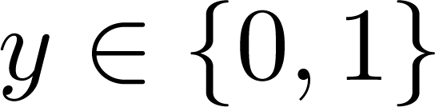

Classification
Email: Spam / Not Spam?
Online Transactions: Fraudulent (Yes / No)?
Tumor: Malignant / Benign ?
0: “Negative Class” (e.g., benign tumor)
1: “Positive Class” (e.g., malignant tumor)

Slide 3
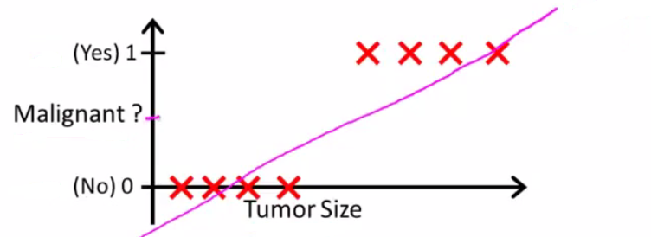
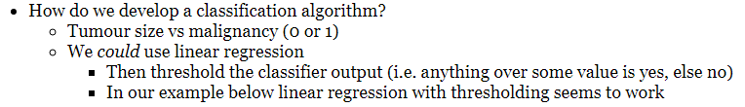
(Yes) 1
Malignant ?
(No) 0
Tumor Size
Tumor Size

Slide 4
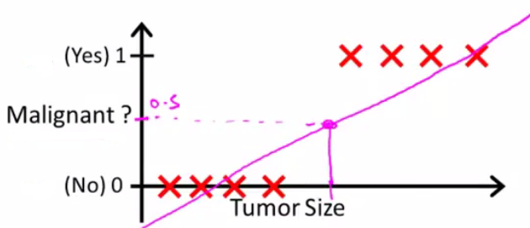

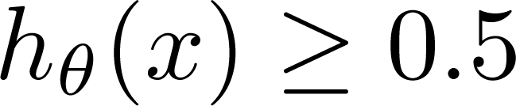
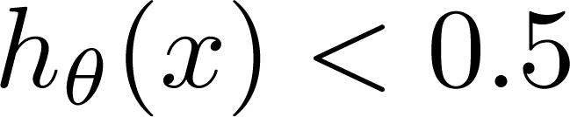
Threshold classifier output at 0.5:
If , predict “y = 1”
If , predict “y = 0”

Slide 5
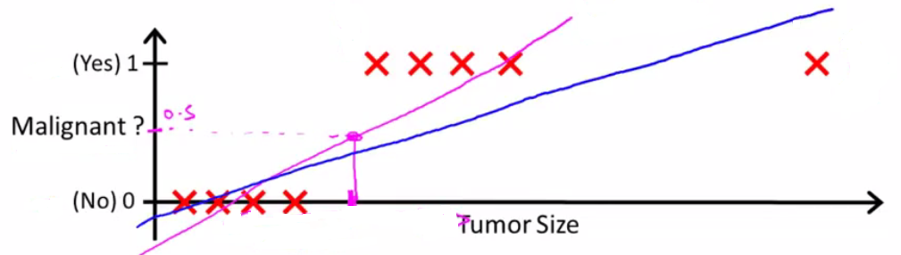
(Yes) 1
Malignant ?
(No) 0
Tumor Size
Tumor Size

Slide 6
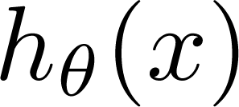
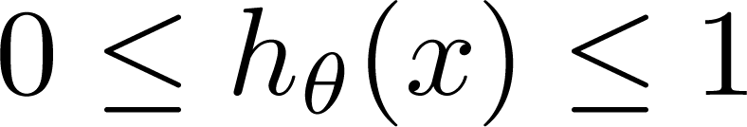
Classification: y = 0 or 1
can be > 1 or < 0
Logistic Regression:

Slide 7
Hypothesis Representation
Logistic
Regression
Machine Learning

Slide 8
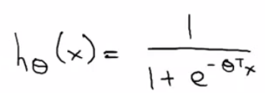
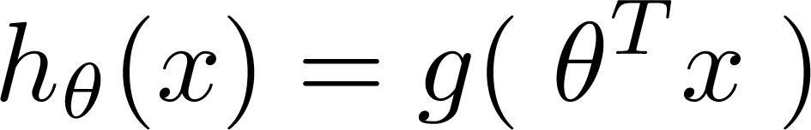
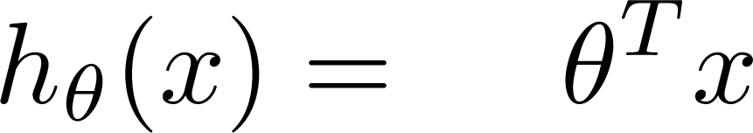
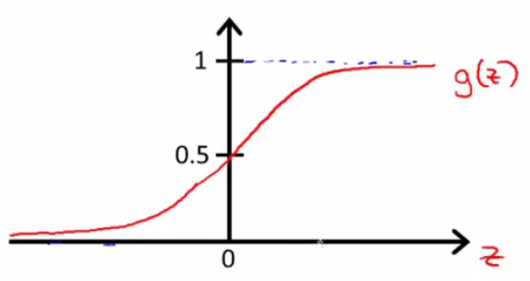
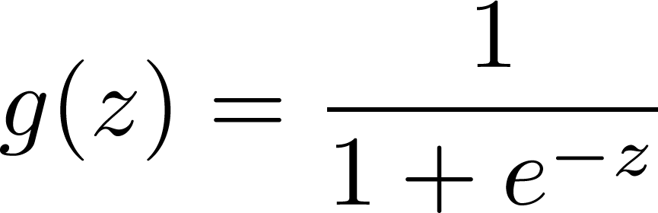
Logistic Regression Model
Want
1
0.5
Sigmoid function
Logistic function
0

Slide 9
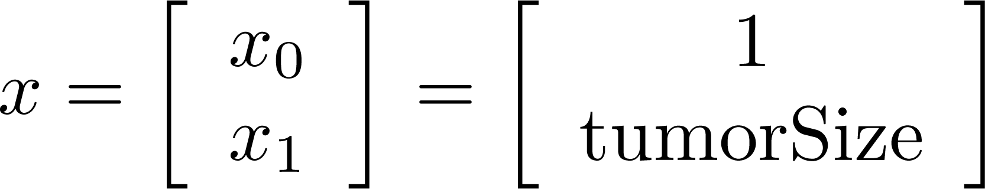
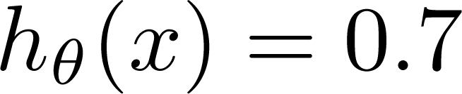
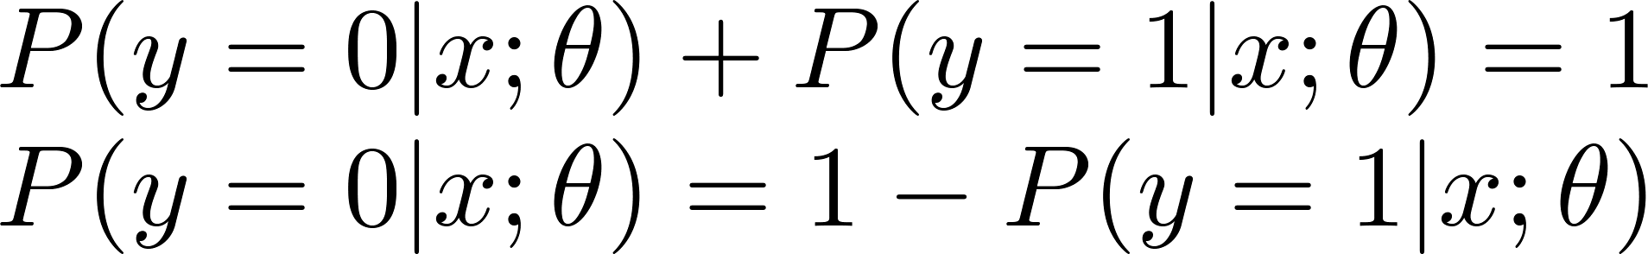
Interpretation of Hypothesis Output
= estimated probability that y = 1 on input x
Example: If
Tell patient that 70% chance of tumor being malignant
“probability that y = 1, given x,
parameterized by ”

Slide 10
Decision boundary
Logistic
Regression
Machine Learning

Slide 11
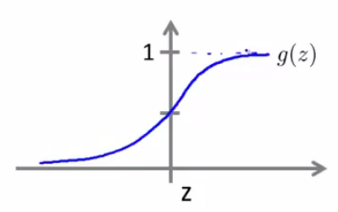

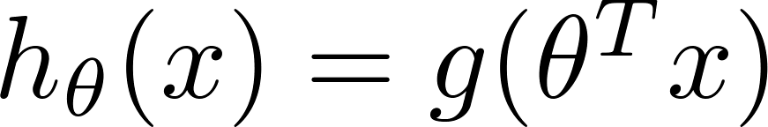
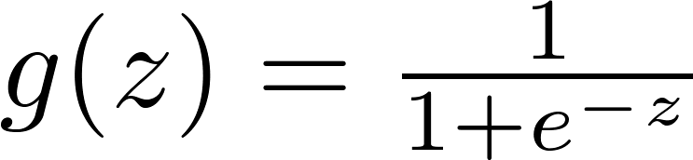

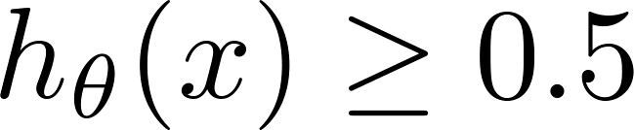

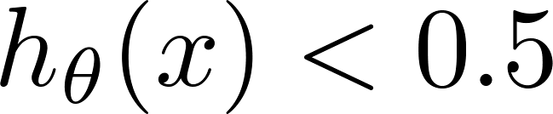
Logistic regression
1
z
Suppose predict “ “ if
predict “ “ if

Slide 12

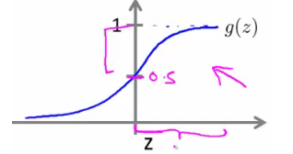
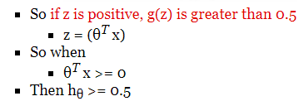

Slide 13
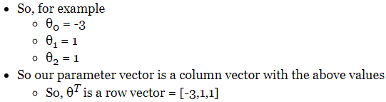
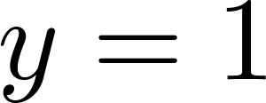
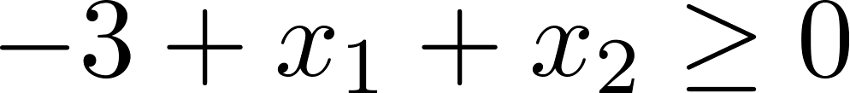
Decision Boundary
x₂
3
2
1
1
2
3
x₁
Predict “ “ if

Slide 14
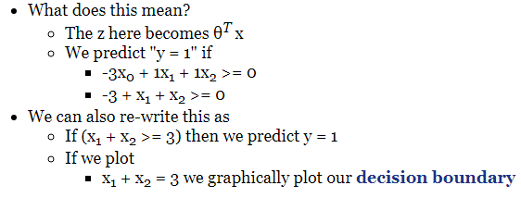
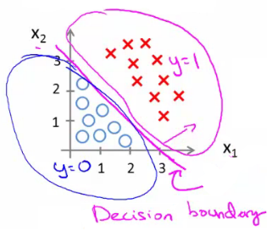
Decision Boundary
x₂
3
2
1
1
2
3
x₁
Predict “ “ if

Slide 15
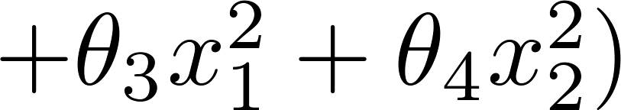
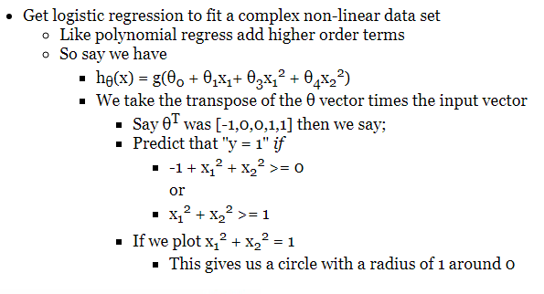
Non-linear decision boundaries
x₂
1
x₁
-1
1
-1
x₂

Slide 16
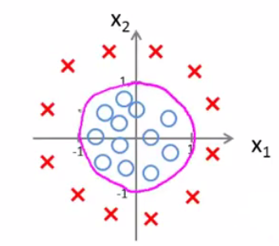
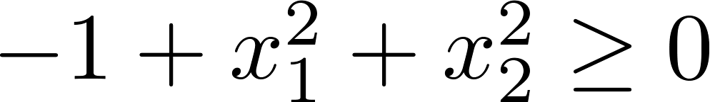
Non-linear decision boundaries
x₂
1
x₁
-1
1
-1
Predict “ “ if
x₂

Slide 17
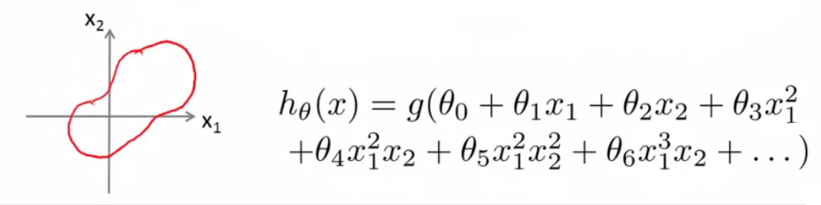
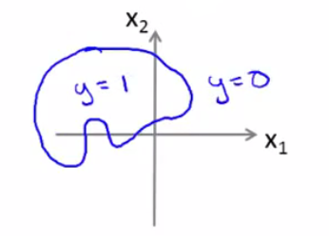
Non-linear decision boundaries

Slide 18
Cost function
Logistic
Regression
Machine Learning

Slide 19
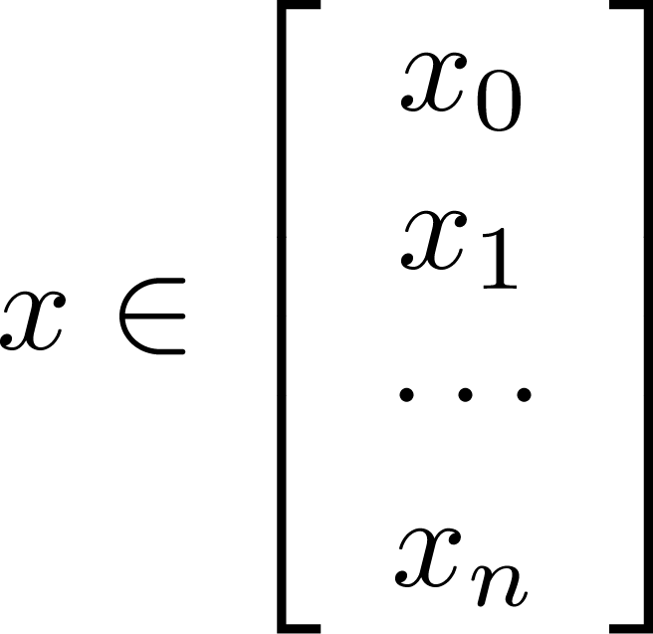
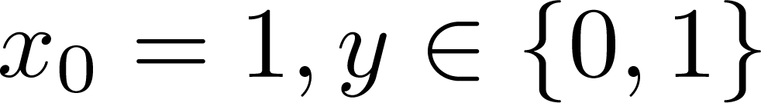
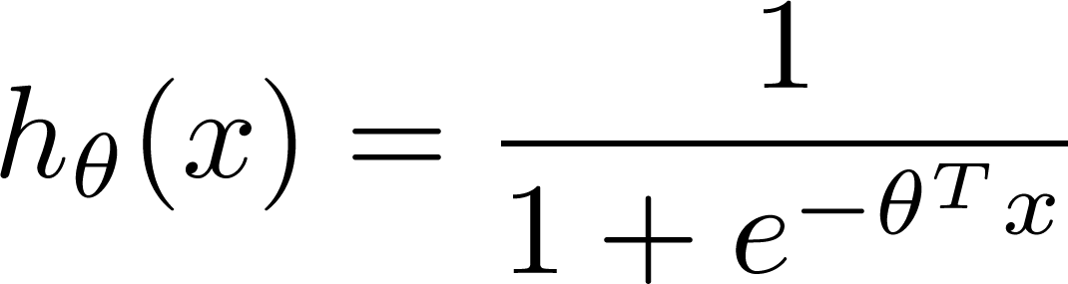

Training set:
m examples
How to choose parameters ?

Slide 20
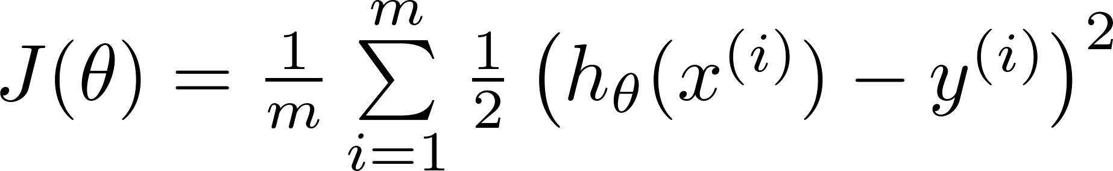
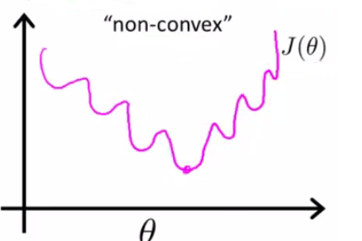
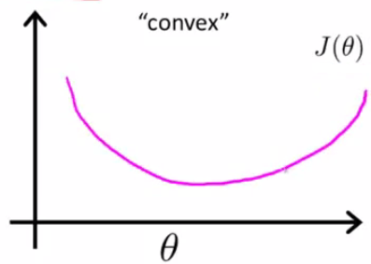

Cost function
Linear regression:
“non-convex”
“convex”

Slide 21
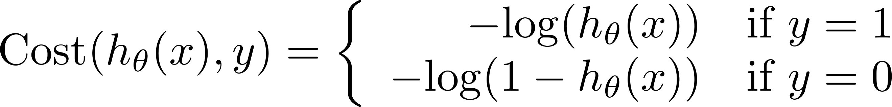
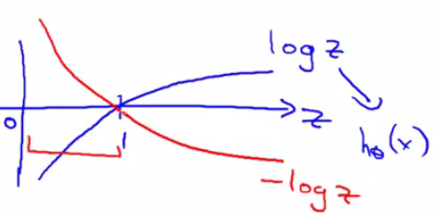
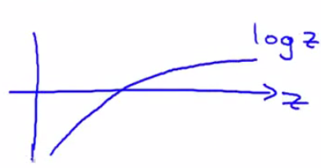
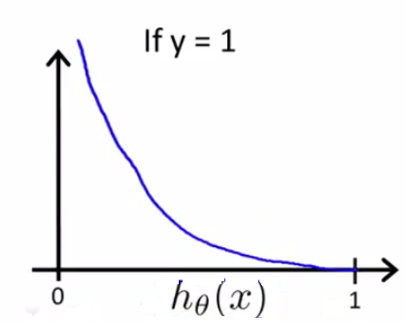
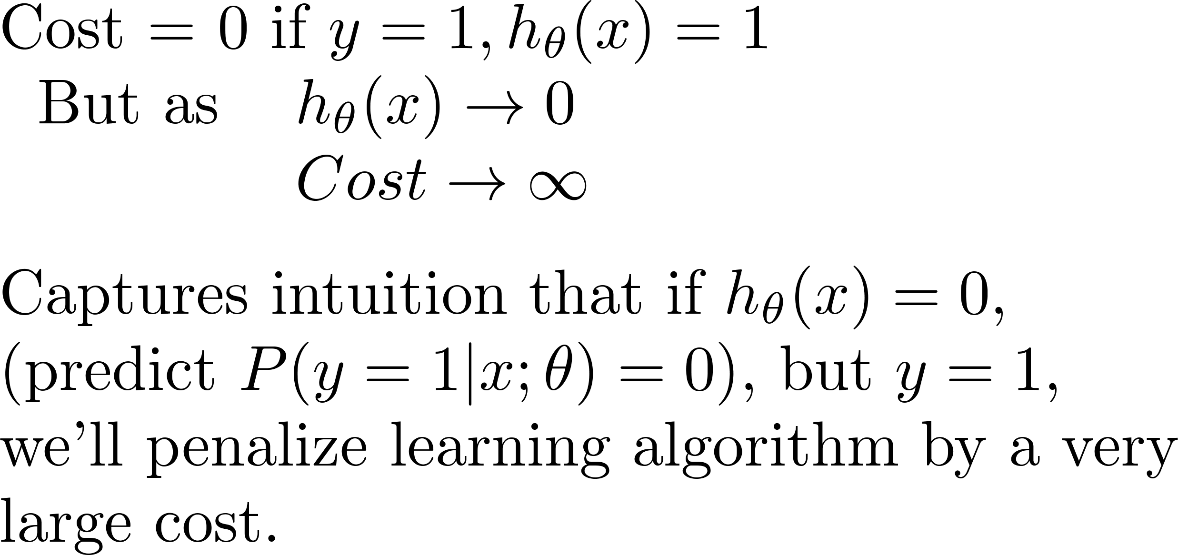
Logistic regression cost function
If y = 1
0
1

Slide 22
Logistic regression cost function
If y = 0
0
1

Slide 23
Simplified cost function and gradient descent
Logistic
Regression
Machine Learning

Slide 24
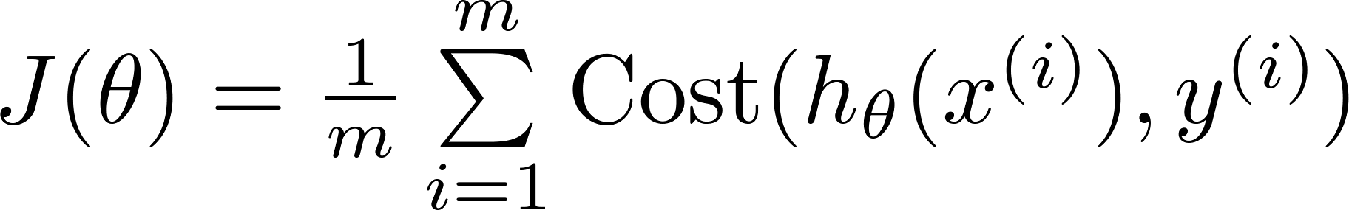

Logistic regression cost function

Slide 25

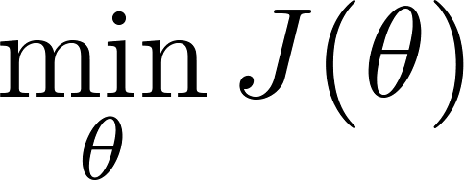

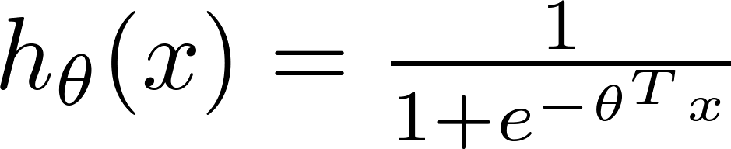
Logistic regression cost function
To fit parameters :
To make a prediction given new :
Output

Slide 26


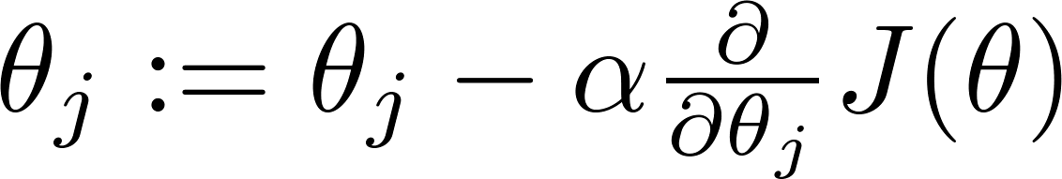


Gradient Descent
Want :
Repeat
(simultaneously update all )

Slide 27

Gradient Descent
Want :
Repeat
(simultaneously update all )
Algorithm looks identical to linear regression!

Slide 28
Multi-class classification: One-vs-all
Logistic
Regression
Machine Learning

Slide 29
Multiclass classification
Email foldering/tagging: Work, Friends, Family, Hobby
Medical diagrams: Not ill, Cold, Flu
Weather: Sunny, Cloudy, Rain, Snow

Slide 30
Binary classification:
Multi-class classification:
x₂
x₂
x₁
x₁

Slide 31


x₂
One-vs-all (one-vs-rest):
x₁
x₂
x₂
x₁
x₁
Class 1:
Class 2:
Class 3:
x₂
x₁

Slide 32




One-vs-all
Train a logistic regression classifier for each class to predict the probability that .
On a new input , to make a prediction, pick the class that maximizes

